Slide 1
ELISA

Slide 2
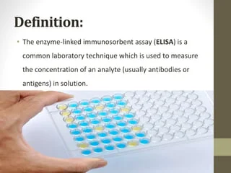

Slide 3
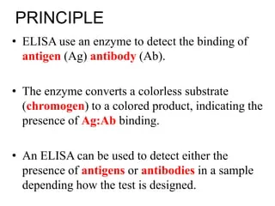
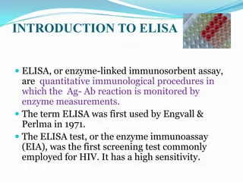

Slide 4
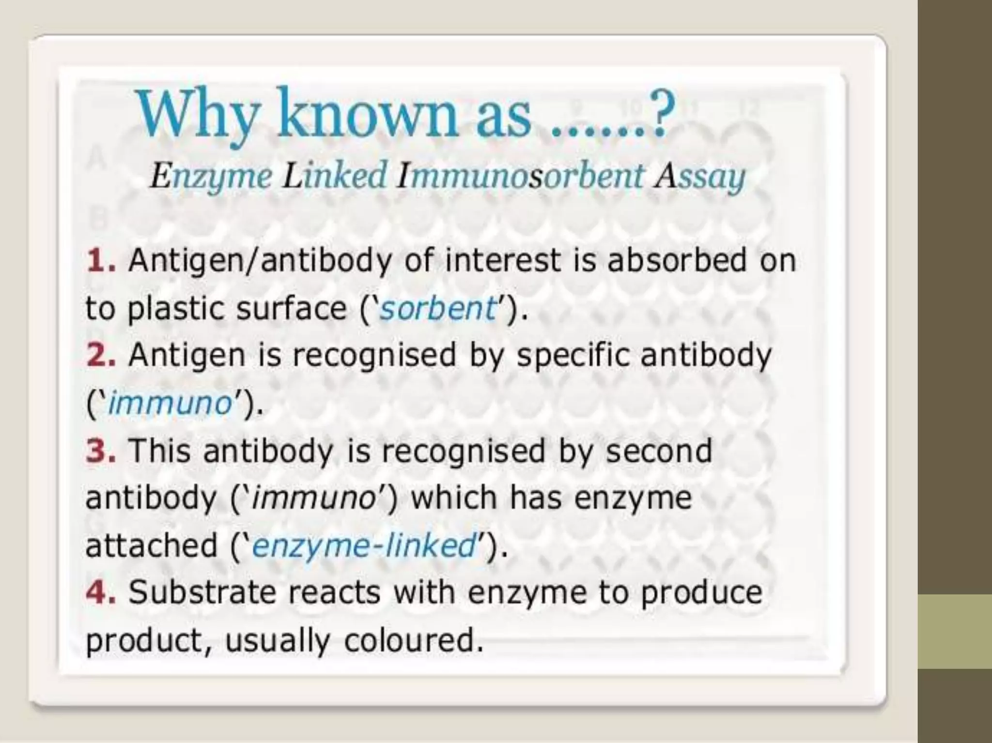

Slide 5
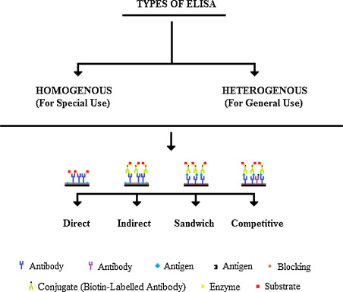

Slide 6
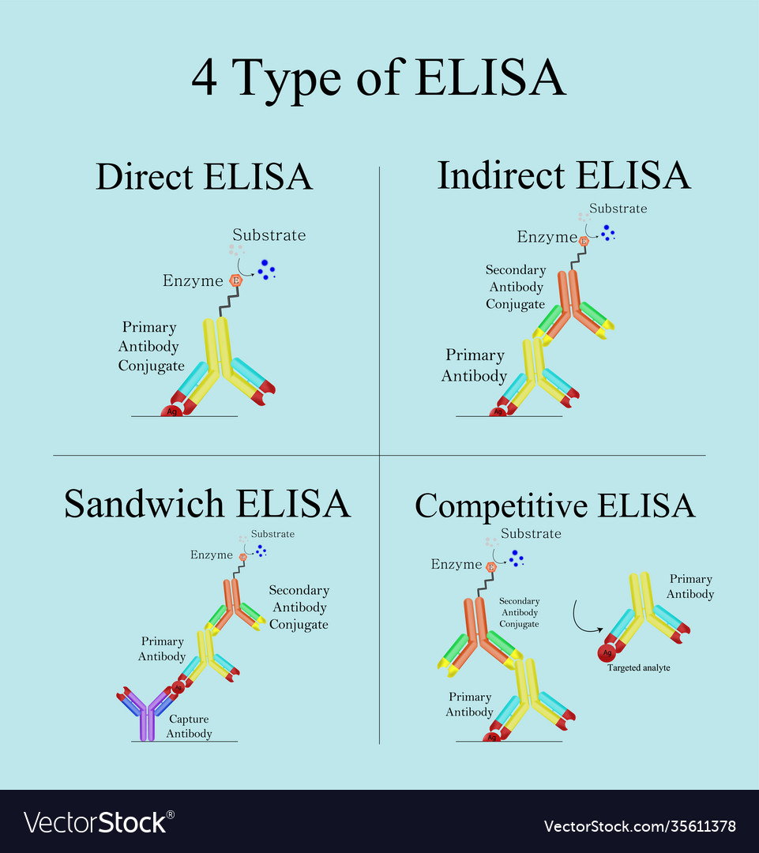

Slide 7
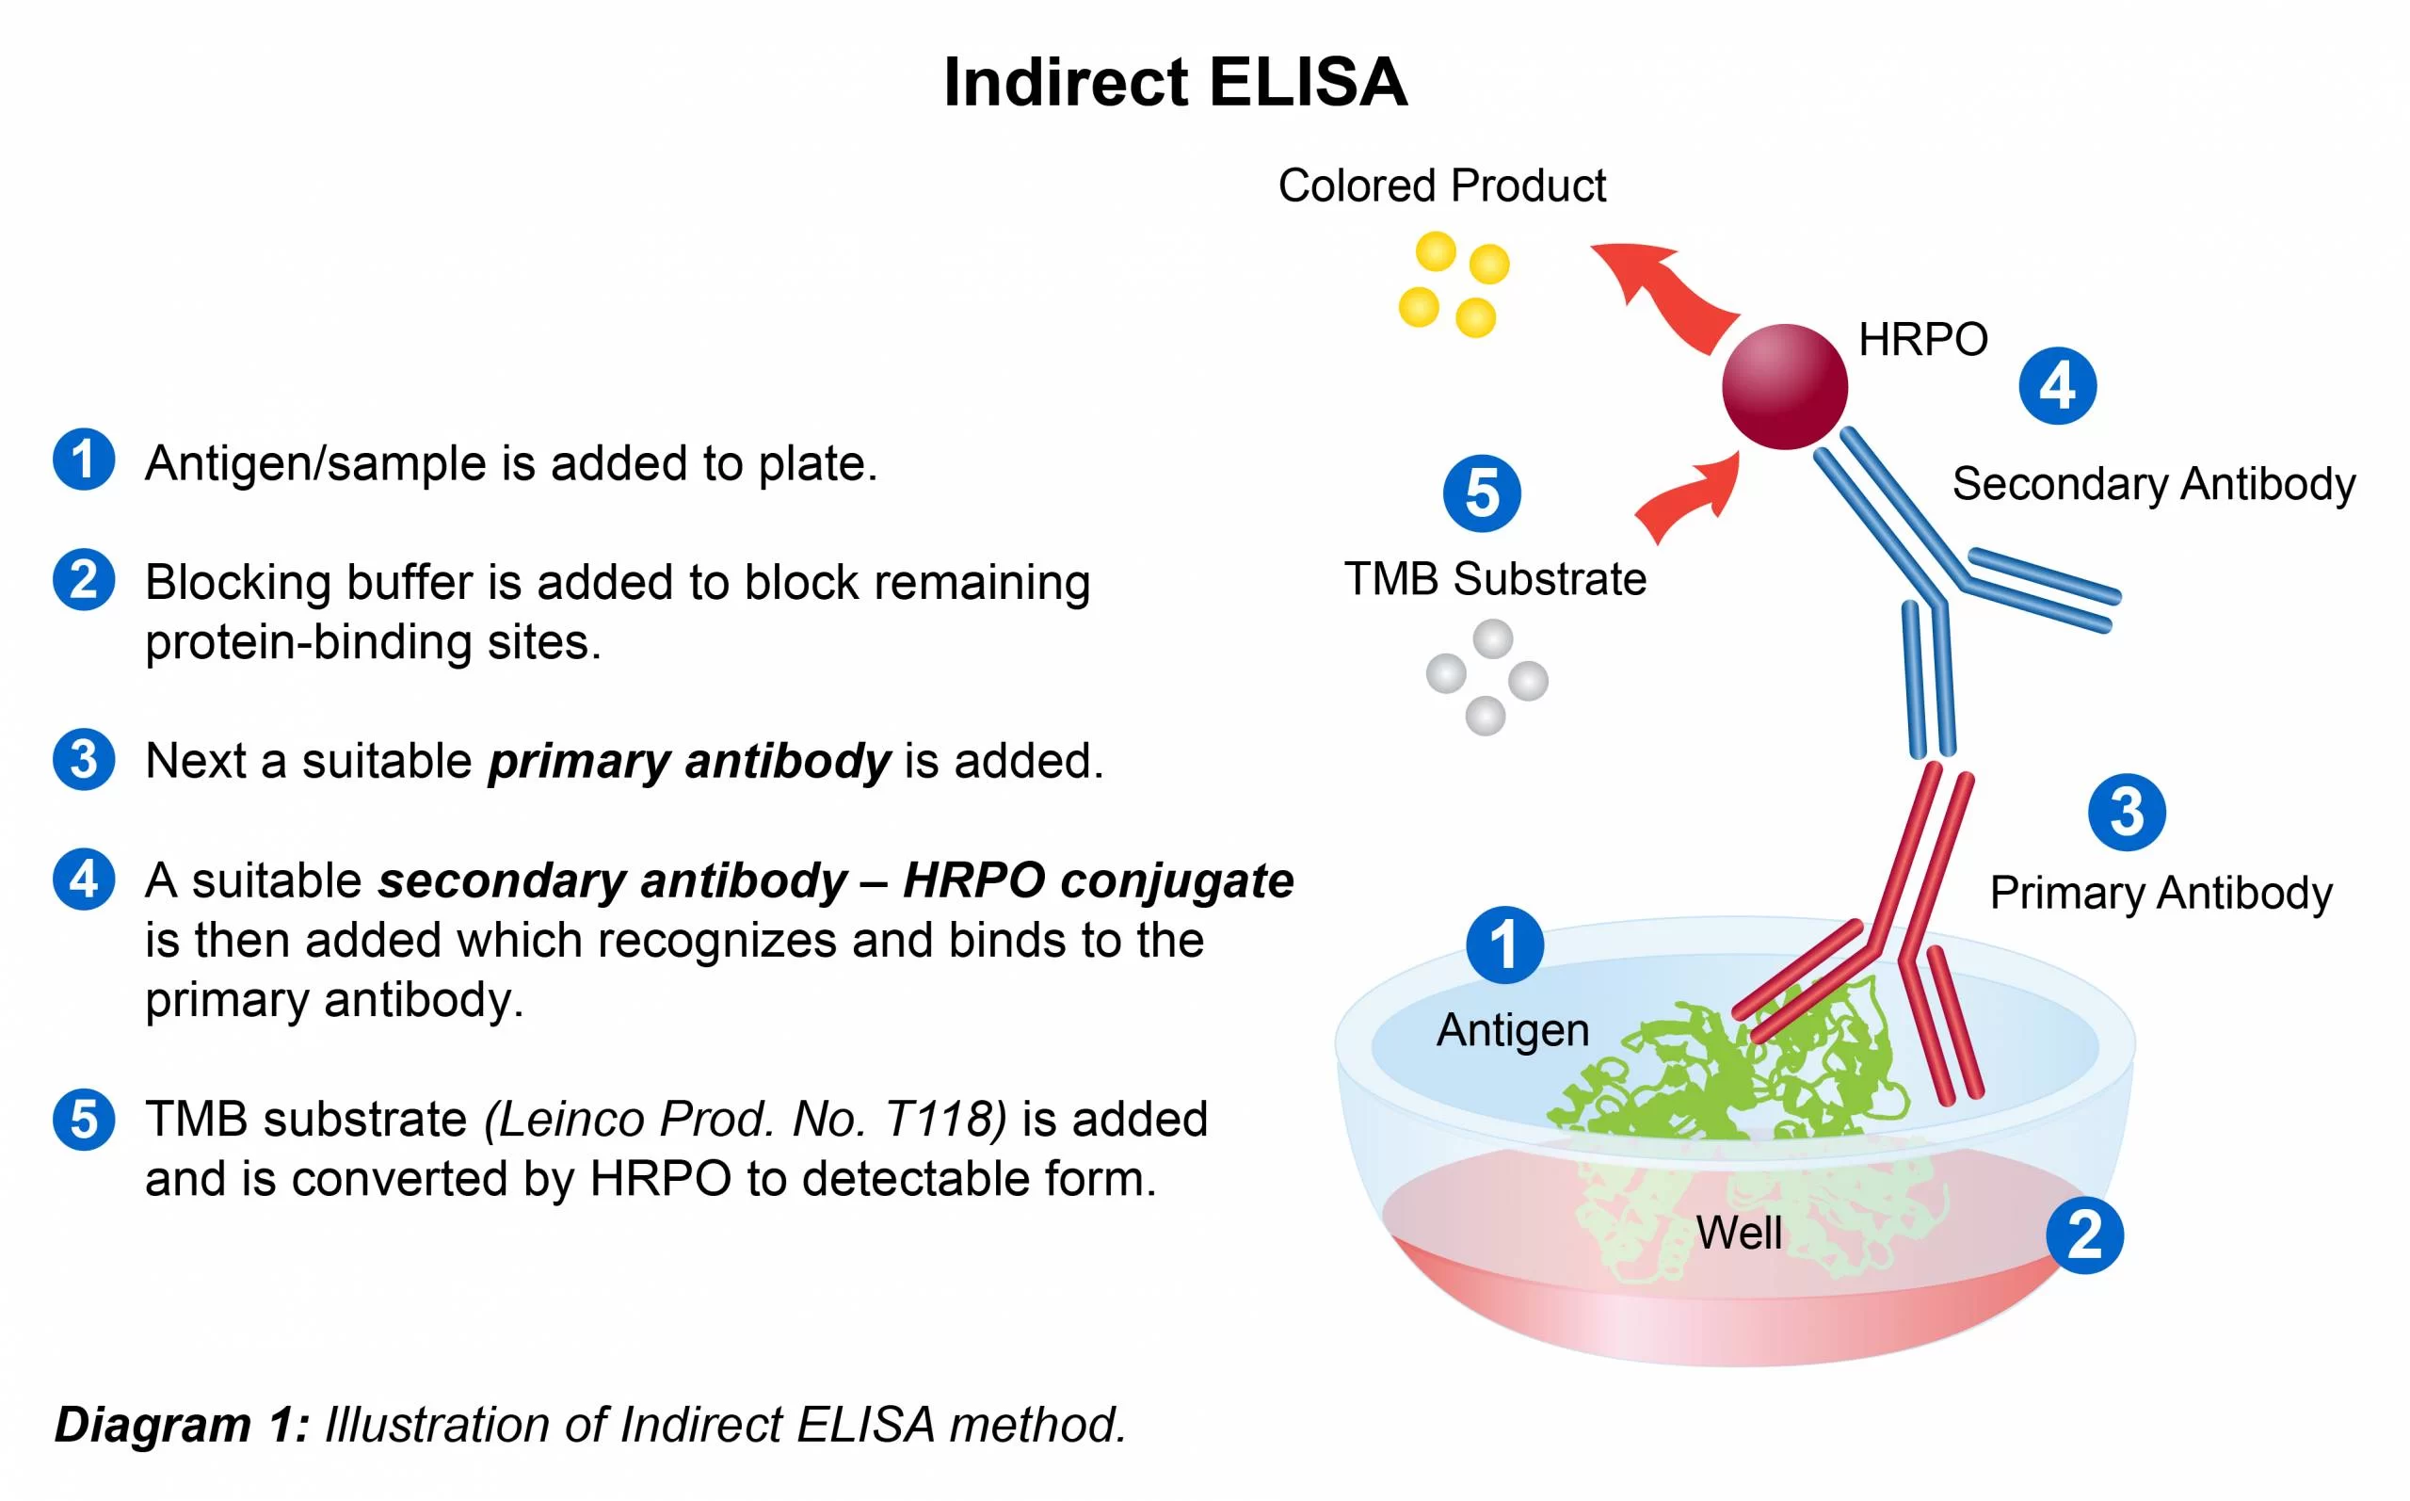

Slide 8
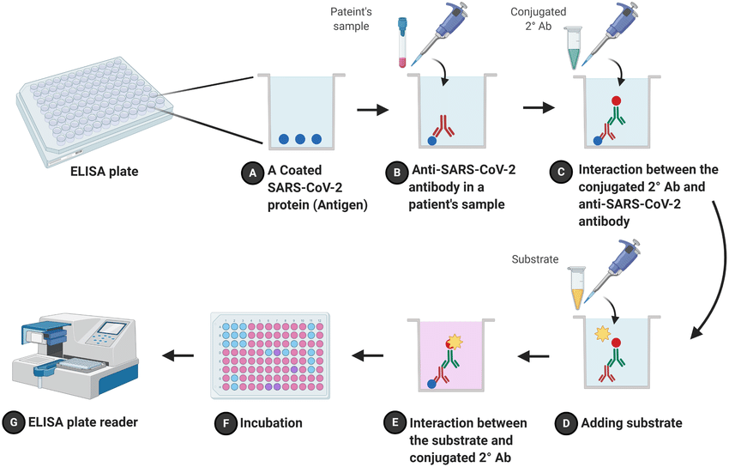

Slide 9
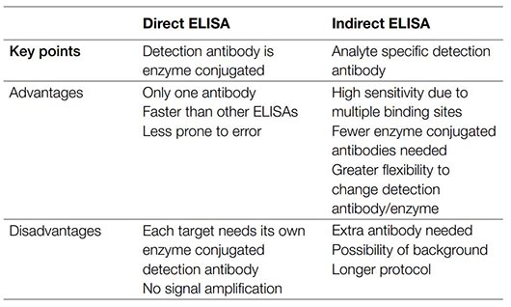

Slide 10
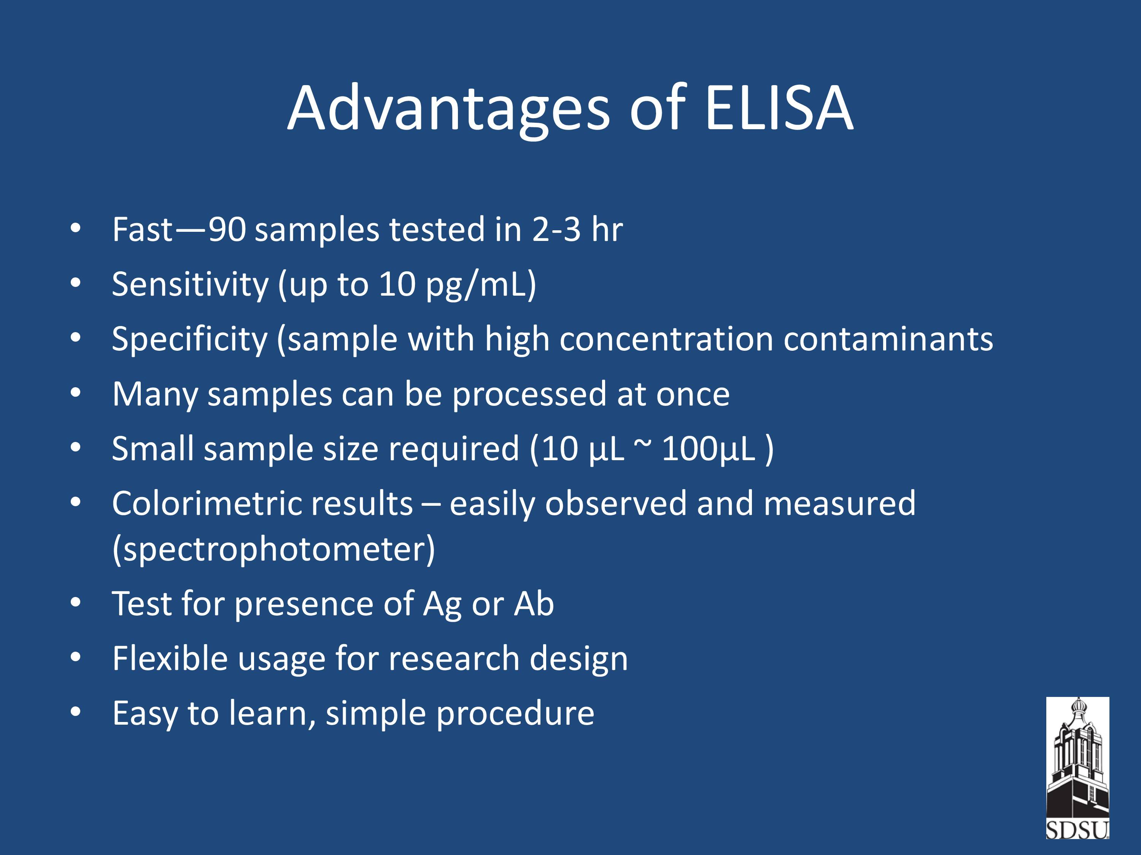

Slide 11
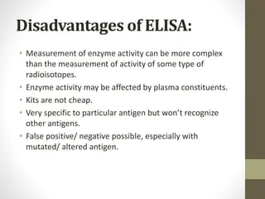

Slide 12
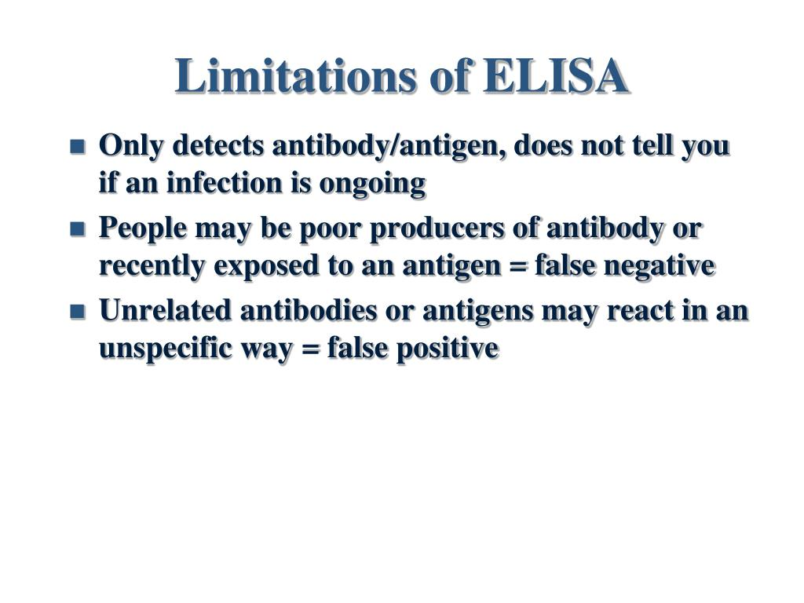

Slide 13
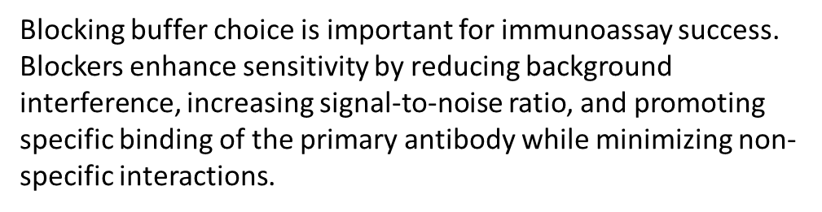
Procedure:
Day 1: Coating of wells with antigen
1. Dilute 30 μl of Antigen with 5.97 ml of coating buffer. Concentration of the diluted capture antigen is 5 μg/ml.
2. Pipette 200 μl of diluted capture antigen into each of the microtitre well (24 wells). Tap or shake the plate so that the capture antigen solution is evenly distributed over the bottom of each well.
3. Incubate the microtitre wells overnight at 4°C.
Day 2: Blocking the residual binding sites on the wells
4. Discard the well contents. Rinse the wells with distilled water for three times by draining out the water after each rinse.
5. Fill each well with 200 μl of blocking buffer and incubate at room temperature for 1 hour.
6. Rinse the plate three times (as given above) with distilled water. Drain out the water completely by tapping the plate on a blotting paper.

Slide 14
Addition of antibody to wells
7. Prepare standard and test antibody dilutions as given above.
8. Add 200 μl of standard antibody, test samples and 1X PBST (wash buffer) to the coated wells (in duplicates).
9. Incubate at room temperature for 30 minutes.
10. Discard the well contents; fill the wells with 1X PBST, allow it to stand for 3 minutes, discard the contents.
Repeat this step twice.
Addition of HRP labeled antibody
11. Dilute 5 μl of Secondary Antibody-HRP conjugate with 5 ml of sample diluent.
12. Add 200 μl of diluted HRP labeled antibody to all the wells.
13. Incubate at room temperature for 30 minutes.
14. Discard the well contents and rinse the wells 3 times with 1X PBST (wash buffer).

Slide 15
Addition of substrate and measurement of absorbance
15. Dilute required amount of 10 X TMB substrate solution to 1X using distilled water.
16. Add 200 μl of 1X TMB substrate to each well.
17. Incubate at room temperature for 10 minutes.
18. Add 100 μl of stop solution to each well.
19. Transfer the contents of each well to individual tubes containing 2 ml of stop solution.
20. Prepare substrate blank by adding 200 μl of 1X substrate solution to 2.1 ml of stop solution.
21. Read the absorbance at 450 nm after blanking the spectrophotometer with substrate blank

